Slide 1
Image Processing and Pattern Recognition (IPPR):
(Lecture 8)

Slide 2
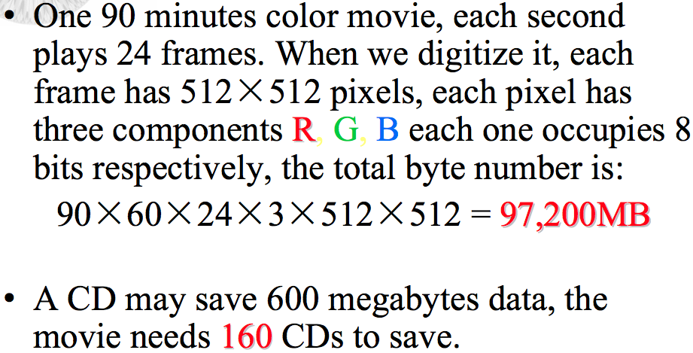
Why we need image compression?

Slide 3
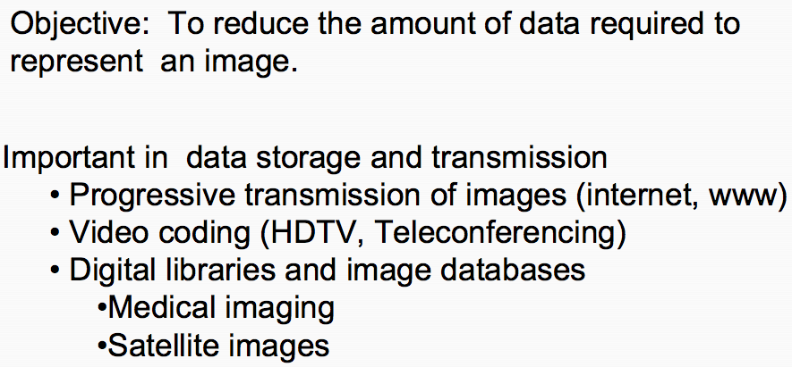
Image Compression

Slide 4
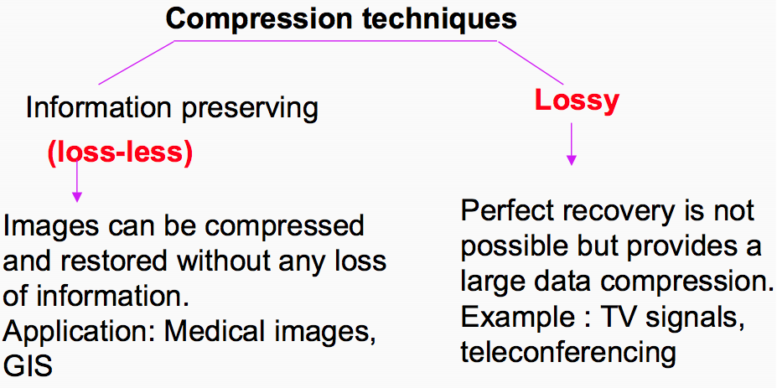
Lossy Vs. Lossless Compression

Slide 5
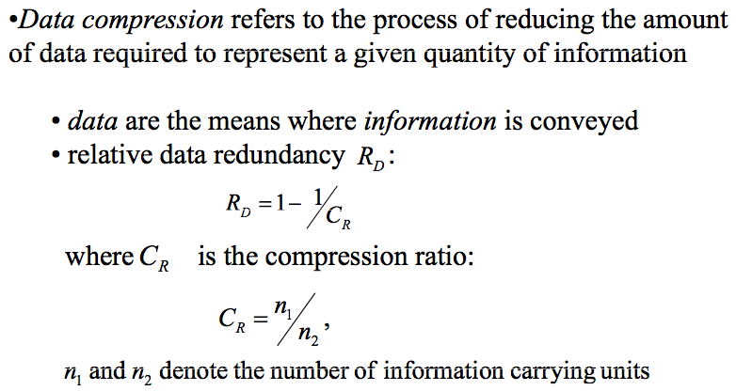
Image Compression

Slide 6
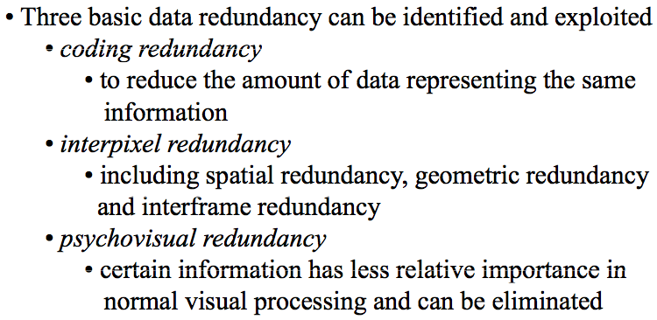
Image Compression

Slide 7
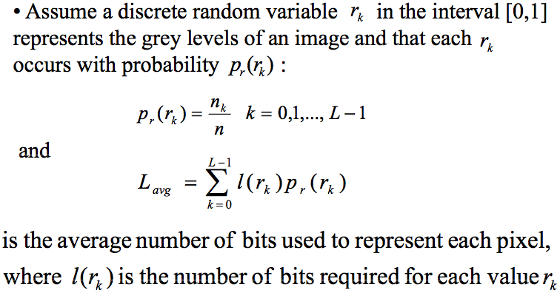
Coding Redundancy

Slide 8
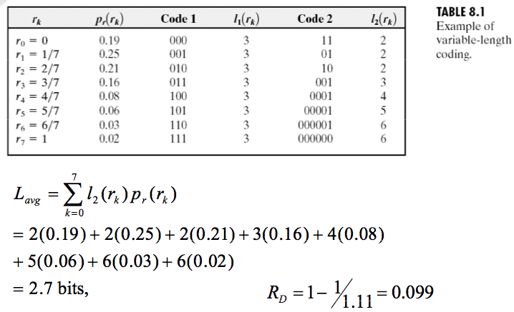
Coding Redundancy

Slide 9
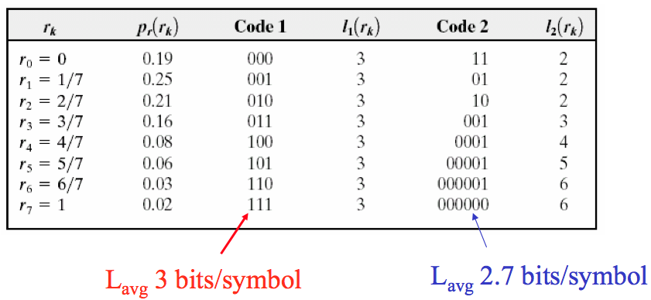
Coding Redundancy

Slide 10
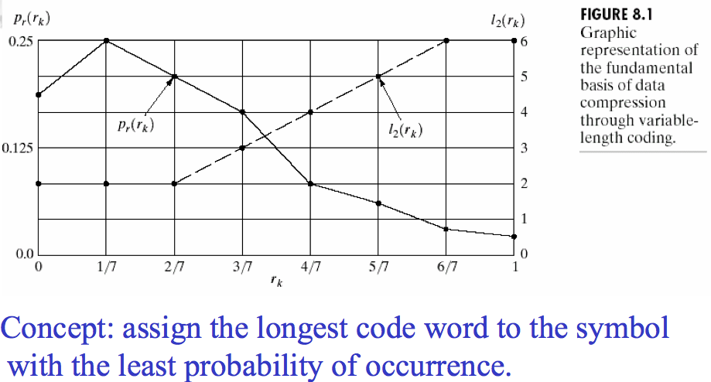
Coding Redundancy

Slide 11
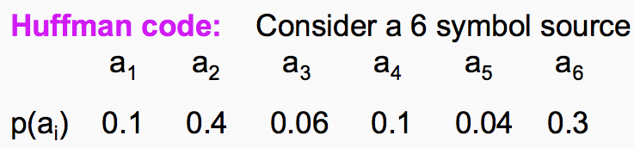
Huffman coding

Slide 12
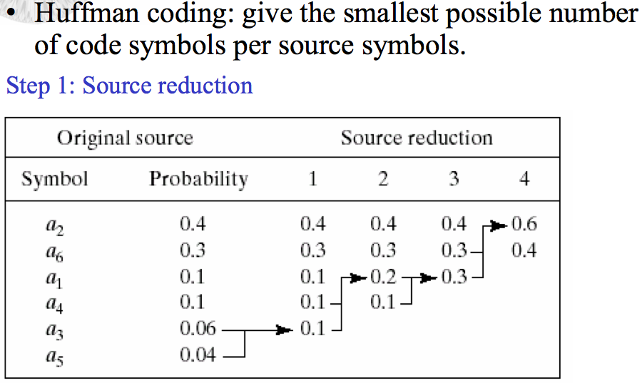
Huffman coding

Slide 13
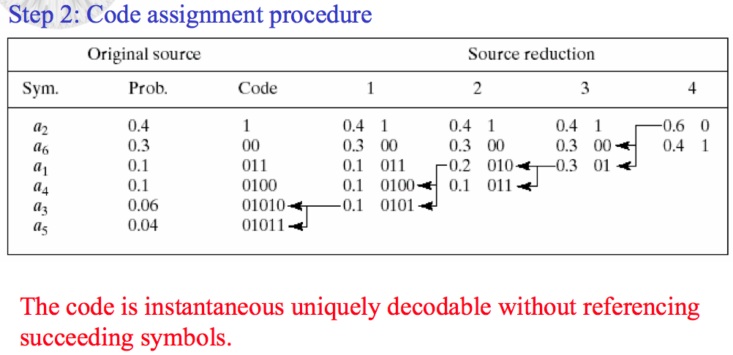
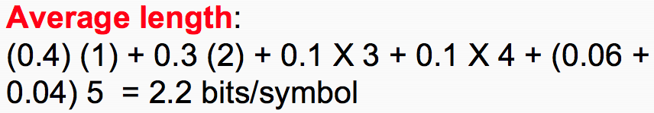
Huffman coding

Slide 14
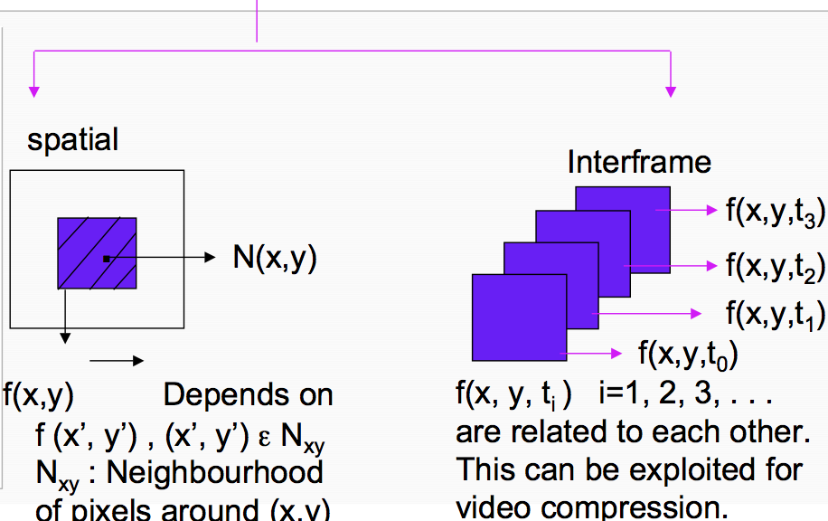
Interpixel / Interframe Redundancy

Slide 15
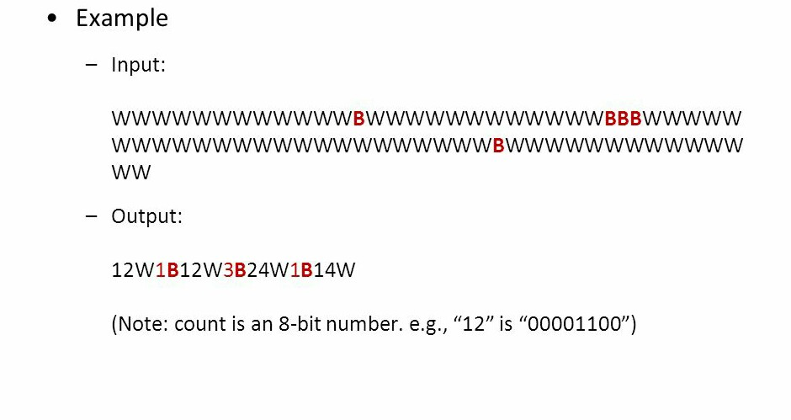
Run length coding

Slide 16
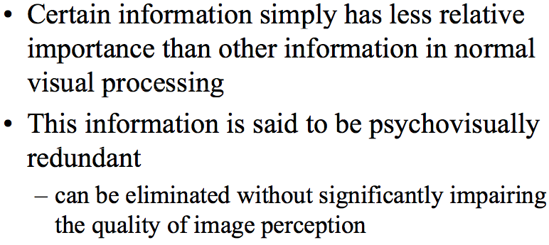
Psychovisual Redundancy

Slide 17
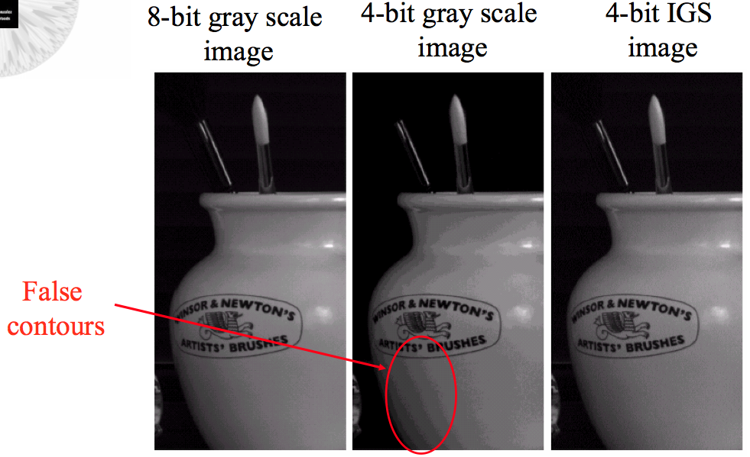
Psychovisual Redundancy

Slide 18
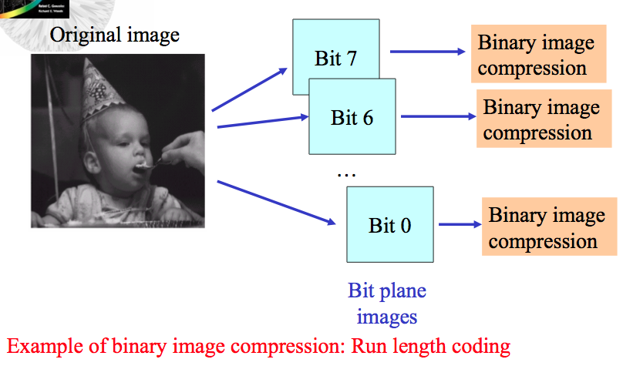
Bit Plane Coding

Slide 19
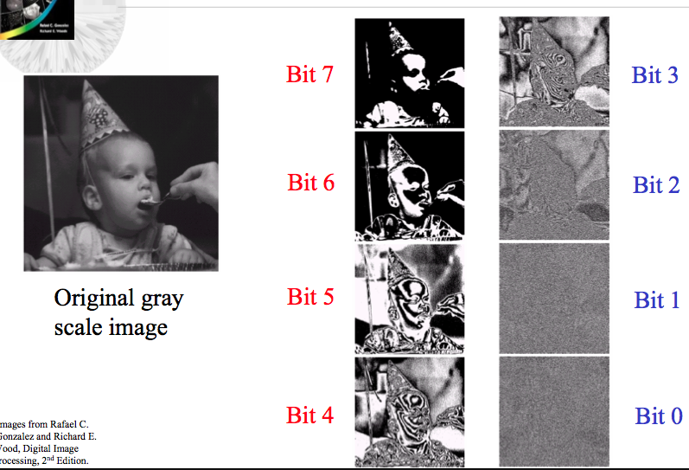
Bit Plane Coding

Slide 20
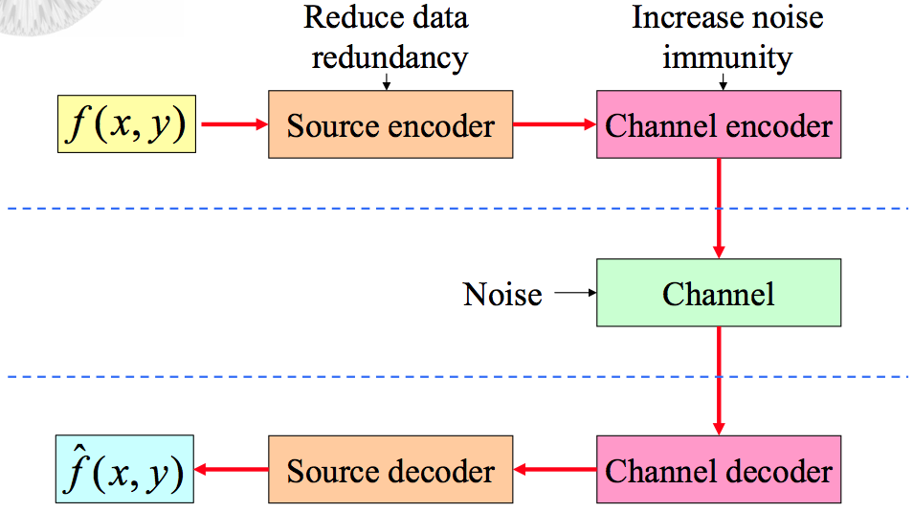
Image Compression Models

Slide 21
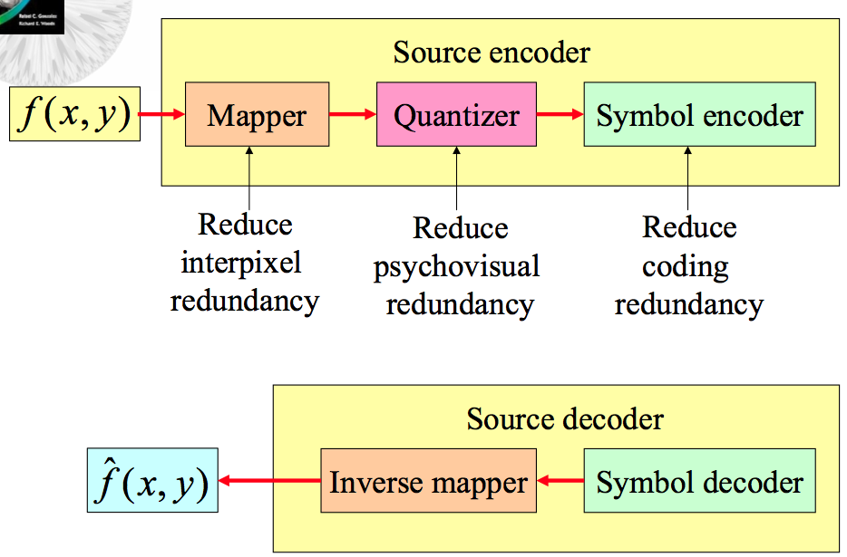
Source Encoder and Decoder Models

Slide 22
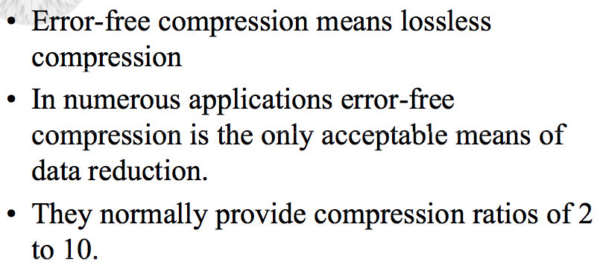
Error-Free Compression (Lossless)

Slide 23
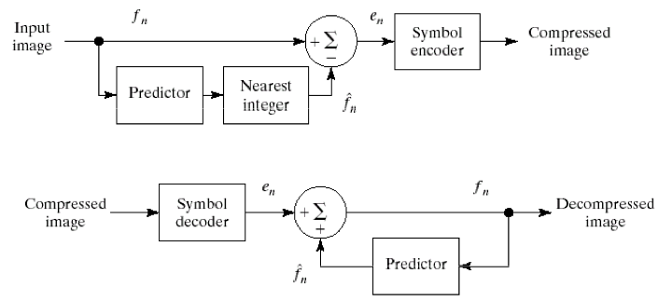
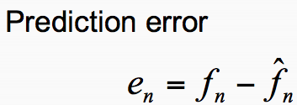
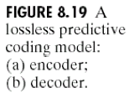
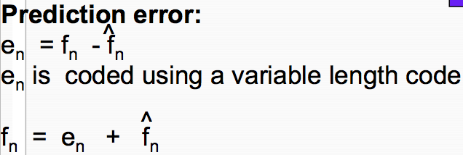
Lossless Predictive Coding Model

Slide 24
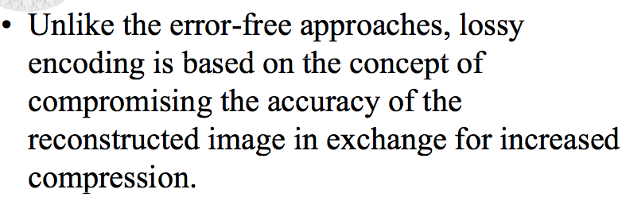
Lossy Compression

Slide 25
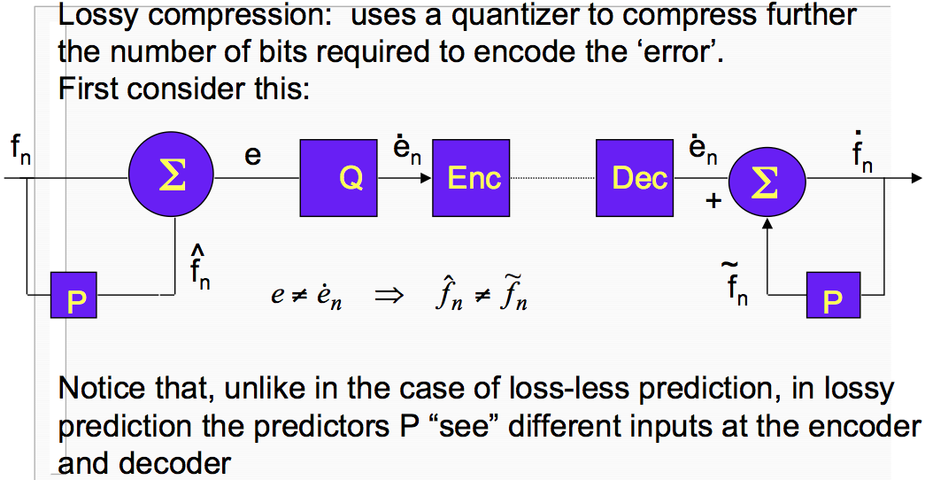
Lossy Compression

Slide 26
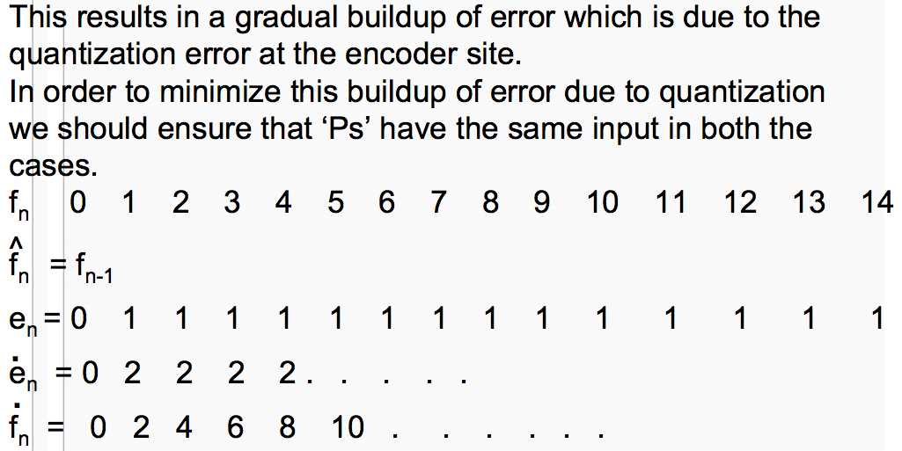
Lossy Compression

Slide 27






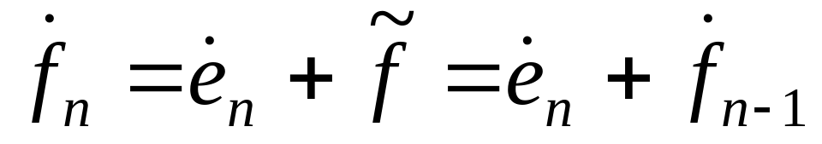
Lossy Compression
0 | 0 | - | - | - | 0
1 | 1 | 0 | 1 | 2 | 2
2 | 2 | 1 | 1 | 2 | 4
3 | 3 | 2 | 1 | 2 | 6
4 | 4 | 3 | 1 | 2 | 8
5 | 5 | 4 | 1 | 2 | 10
6 | 6 | 5 | 1 | 2 | 12

Slide 28
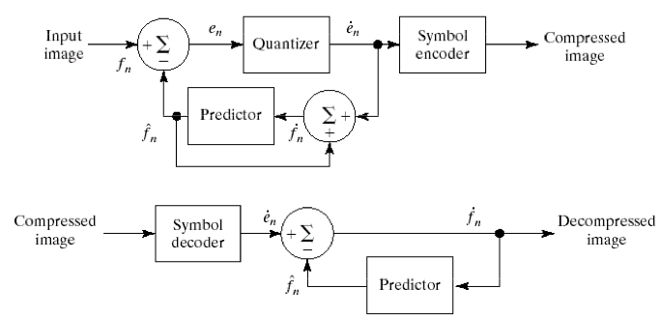
Lossy Compression

Slide 29
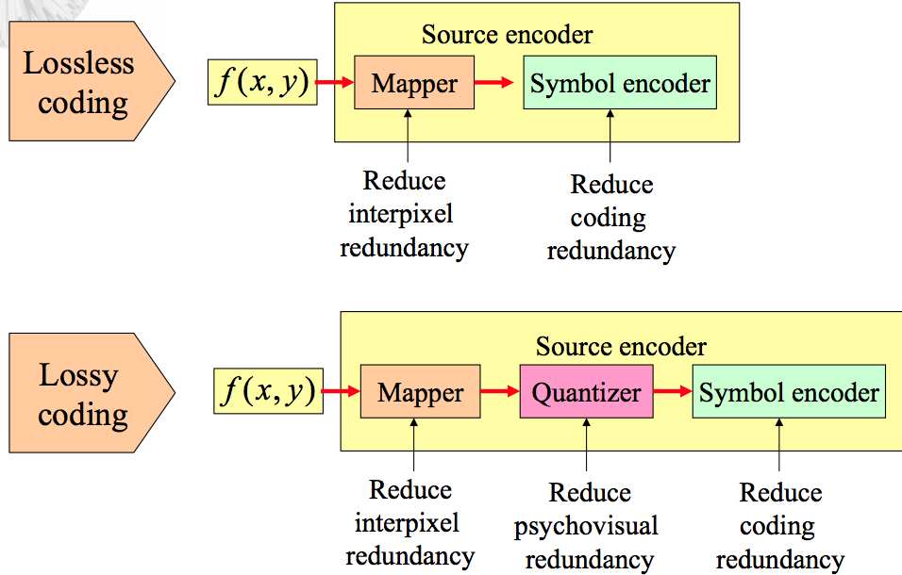
Lossless Vs. Lossy Coding

